Slide 1
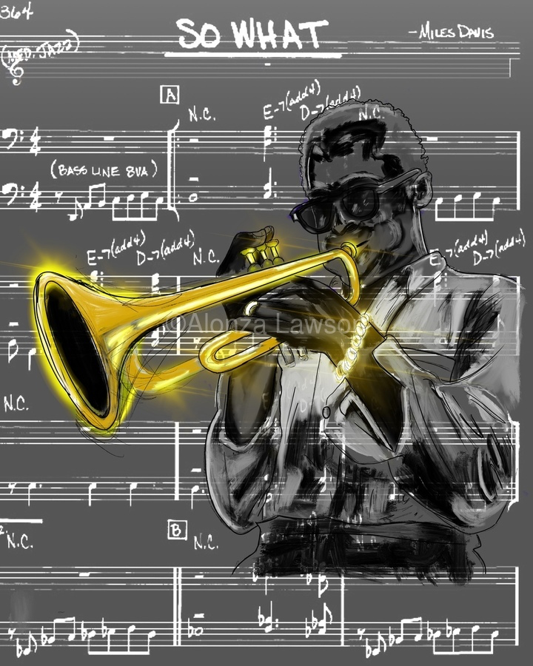
Measuring intention and emotional involvement in jazz music
Anna Jordanous
Notes:
Hypothesis: • if an improvisation contains more evidence of emotion-laden content, it is more likely to be recognised as creative What do I need • data ranking most creative improvisations • data for multiple improvisations • ml model eg transformer trained on valence/arousal (soleymani et al?) - benetos et al 2021? Assumption that git repo using Spotipy won't work any more • library to calculate J&L features - librosa? Super collider? • do I want to get human input for validation? Or is the ranking enough? • Data on popularity of artists in dataset (spotipy?) • Literature survey on MER music emotion recognition, especially anything looking at creativity- MAY INFLUENCE METHOD • Stats method to analyse results across songs • organising data into sets for analysis, need to cross check against data on popularity+year as well as matching across a lead sheet • check for different songs with same name eg moaning Method • collect data as above • implement J&L features for input audio with 5d vector as output (is this actually the first paper? See issues)(and Russell model? With 2d output vector, to see if overall emotion has effect). Output = emovectors? (Check if that had been used) • Get emovectors :) for each song in analysis data • Statistical analysis across songs matched to ranking to verify hypothesis Issues • isolating individual improvisations vs analysing the whole track- this needs to be clearly linked to the rankings • rankings need to be very solid benchmarks • Is the impro creative because of the individual improvising, or the group? I assume collective creativity - why? Because music impro is inherently social (citation) and group impro is constructed around interaction (cite, jazz theory examples too) * to what extent does the chord sequence/ lead sheet melody influence creativity? In this work, this is controlled for through analysing multiple examples over the same chord sequence. Where possible, will also compare improvisations seeded from different lead sheet melodies, using the same chord sequence eg 12 bar blues, rhythm changes * Rankings will be biased by popularity of the musicians involved and how well known they are - control by looking at tracks matched by rough date, and also will be interesting to evaluate newer tracks by lesser known artists - can I detect up and coming stars? (Can use spotipy for metadata on artist popularity, will need to be scaled relative to all jazz artists in my dataset) * jazz is a term that covers many sub genres, how appropriate is it to compare, say free jazz to dixie? ..... maybe can check this in analysis if deep enough data * what about improvisations that aren't jazz? Maybe i need to be careful here and say 'impro' rather than jazz, though that might not work as the leadsheet/chord sequence idea is inspired by jazz. I need to be careful how to frame this. I can emphasise my scope is on improvisations around a lead sheet/ chord sequence model (explain what this is), typically but not exclusively found in jazz impro... acknowledging too that not all jazz is in this model (I can cite Alex Hawkins as example!) * I assume that for J&L all audio features contribute equally to the emotion... check original paper and any follow up work. Can i validate this against any annotated datasets (ideally jazz)? Is this actually the first paper? * is it worth doing analysis across an artist, to calculate their most creative impro? Might be verifiable against people's rankings? Controversial again otherwise, but possible. Difficulty with groups- what is the artist? The lead name on the record? Or that specific combination of musicians? Could be a fun initial experiment pointing to future work? Assumptions: * Improvisation is creative process where the outputs are closely tied to the live process. • emotional content in the music can be used as a proxy for emotional involvement • emotional content can be represented using either Russell valence and arousal model or the 5 key emotions as captured by Juslin and Laukka. Russell ok for summative but not for magnitude, so J&L better? • Intention and emotional involvement are recognised outside my work, as part of the key contributors to musical creativity (alongside social interaction and communication, and domain competence) • I can use 'song' or 'chart' to represent lead sheet plus chord (chart probably better, but more confusing for a non jazzer?) Future work • intention - can this be captured by showing presence of a musical narrative? How? • how does the chord sequence influence creativity potential? Future work on optimising chord sequences for creativity • could analyse creativity of an individual artist across different groups.. see in what groups they (collectively) produce most creative impro..... but difficult to do without

Slide 2
Today’s talk: Measuring intention and emotional involvement in jazz music
Overview of this work in progress
Part of a wider project on optimising AI for creativity
Background
Creativity in music improvisation
Emotions in music
Methodology and results so far
Next steps and issues still to solve
Summary
Notes:
Hypothesis: • if an improvisation contains more evidence of emotion-laden content, it is more likely to be recognised as creative What do I need • data ranking most creative improvisations • data for multiple improvisations • ml model eg transformer trained on valence/arousal (soleymani et al?) - benetos et al 2021? Assumption that git repo using Spotipy won't work any more • library to calculate J&L features - librosa? Super collider? • do I want to get human input for validation? Or is the ranking enough? • Data on popularity of artists in dataset (spotipy?) • Literature survey on MER music emotion recognition, especially anything looking at creativity- MAY INFLUENCE METHOD • Stats method to analyse results across songs • organising data into sets for analysis, need to cross check against data on popularity+year as well as matching across a lead sheet • check for different songs with same name eg moaning Method • collect data as above • implement J&L features for input audio with 5d vector as output (is this actually the first paper? See issues)(and Russell model? With 2d output vector, to see if overall emotion has effect). Output = emovectors? (Check if that had been used) • Get emovectors :) for each song in analysis data • Statistical analysis across songs matched to ranking to verify hypothesis Issues • isolating individual improvisations vs analysing the whole track- this needs to be clearly linked to the rankings • rankings need to be very solid benchmarks • Is the impro creative because of the individual improvising, or the group? I assume collective creativity - why? Because music impro is inherently social (citation) and group impro is constructed around interaction (cite, jazz theory examples too) * to what extent does the chord sequence/ lead sheet melody influence creativity? In this work, this is controlled for through analysing multiple examples over the same chord sequence. Where possible, will also compare improvisations seeded from different lead sheet melodies, using the same chord sequence eg 12 bar blues, rhythm changes * Rankings will be biased by popularity of the musicians involved and how well known they are - control by looking at tracks matched by rough date, and also will be interesting to evaluate newer tracks by lesser known artists - can I detect up and coming stars? (Can use spotipy for metadata on artist popularity, will need to be scaled relative to all jazz artists in my dataset) * jazz is a term that covers many sub genres, how appropriate is it to compare, say free jazz to dixie? ..... maybe can check this in analysis if deep enough data * what about improvisations that aren't jazz? Maybe i need to be careful here and say 'impro' rather than jazz, though that might not work as the leadsheet/chord sequence idea is inspired by jazz. I need to be careful how to frame this. I can emphasise my scope is on improvisations around a lead sheet/ chord sequence model (explain what this is), typically but not exclusively found in jazz impro... acknowledging too that not all jazz is in this model (I can cite Alex Hawkins as example!) * I assume that for J&L all audio features contribute equally to the emotion... check original paper and any follow up work. Can i validate this against any annotated datasets (ideally jazz)? Is this actually the first paper? * is it worth doing analysis across an artist, to calculate their most creative impro? Might be verifiable against people's rankings? Controversial again otherwise, but possible. Difficulty with groups- what is the artist? The lead name on the record? Or that specific combination of musicians? Could be a fun initial experiment pointing to future work? Assumptions: * Improvisation is creative process where the outputs are closely tied to the live process. • emotional content in the music can be used as a proxy for emotional involvement • emotional content can be represented using either Russell valence and arousal model or the 5 key emotions as captured by Juslin and Laukka. Russell ok for summative but not for magnitude, so J&L better? • Intention and emotional involvement are recognised outside my work, as part of the key contributors to musical creativity (alongside social interaction and communication, and domain competence) • I can use 'song' or 'chart' to represent lead sheet plus chord (chart probably better, but more confusing for a non jazzer?) Future work • intention - can this be captured by showing presence of a musical narrative? How? • how does the chord sequence influence creativity potential? Future work on optimising chord sequences for creativity • could analyse creativity of an individual artist across different groups.. see in what groups they (collectively) produce most creative impro..... but difficult to do without

Slide 3
Overview – work in progress
This work is part of a wider project on optimising AI for creativity:
“MOOsic: Optimising AI Music Creativity Using Nature-Inspired Multi-Objective Optimisation”
“Creativity is a crucial part of intelligence (and vice versa). Imagine an intelligence without creativity? This project explores the hypothesis that we can optimise Generative AI to be more creative, using multi-objective optimisation.” …
“This project investigates the hypothesis that we can approximate creativity evaluation with domain-specific evaluative tests , such that we can optimise for maximising creativity. The test scenario is music improvisation.”
To establish a specific test case, this workpackage looks specifically at musical improvisation, and in-
vestigates how automated tests for musical improvisation creativity can be implemented and applied.
The evaluation of creativity is based on automating tests of the three criteria identified above as most
contributory to musical improvisation creativity.
We propose using a nature inspired multi-objective optimisation (MOO) based approach, optimising across
multiple factors to maximise the creativity of the musical output. We will evaluate different MOO-based
approaches such as lexicographic and Pareto based algorithms, comparing them to each other, and to
current state of the art in music generation techniques. We will evaluate a hypothesis that a Pareto-front
approach is particularly well suited to this task. Over other approaches to MOO, such as a lexicographic-
based approach or weighted formula that require additional information (lexicographic ordering) or optimi-
sation steps (objective weights).
Music improvisation creativity is influenced by three key factors [7], which we treat here as three key ob-
jectives for optimisation. We use current state of the art music generators and evaluate whether the intro-
duction of multi-objective optimisation increases the perceived creativity of the generated output. and this
allows us to incorporate evaluation in the creative process of music generators.
These proposals (implementing creativity metrics in multi-objective optimisation) are the first to use cre-
ativity evaluation to enable transformer-based AI software to develop more creativity algorithmically.
Notes:
Hypothesis: • if an improvisation contains more evidence of emotion-laden content, it is more likely to be recognised as creative What do I need • data ranking most creative improvisations • data for multiple improvisations • ml model eg transformer trained on valence/arousal (soleymani et al?) - benetos et al 2021? Assumption that git repo using Spotipy won't work any more • library to calculate J&L features - librosa? Super collider? • do I want to get human input for validation? Or is the ranking enough? • Data on popularity of artists in dataset (spotipy?) • Literature survey on MER music emotion recognition, especially anything looking at creativity- MAY INFLUENCE METHOD • Stats method to analyse results across songs • organising data into sets for analysis, need to cross check against data on popularity+year as well as matching across a lead sheet • check for different songs with same name eg moaning Method • collect data as above • implement J&L features for input audio with 5d vector as output (is this actually the first paper? See issues)(and Russell model? With 2d output vector, to see if overall emotion has effect). Output = emovectors? (Check if that had been used) • Get emovectors :) for each song in analysis data • Statistical analysis across songs matched to ranking to verify hypothesis Issues • isolating individual improvisations vs analysing the whole track- this needs to be clearly linked to the rankings • rankings need to be very solid benchmarks • Is the impro creative because of the individual improvising, or the group? I assume collective creativity - why? Because music impro is inherently social (citation) and group impro is constructed around interaction (cite, jazz theory examples too) * to what extent does the chord sequence/ lead sheet melody influence creativity? In this work, this is controlled for through analysing multiple examples over the same chord sequence. Where possible, will also compare improvisations seeded from different lead sheet melodies, using the same chord sequence eg 12 bar blues, rhythm changes * Rankings will be biased by popularity of the musicians involved and how well known they are - control by looking at tracks matched by rough date, and also will be interesting to evaluate newer tracks by lesser known artists - can I detect up and coming stars? (Can use spotipy for metadata on artist popularity, will need to be scaled relative to all jazz artists in my dataset) * jazz is a term that covers many sub genres, how appropriate is it to compare, say free jazz to dixie? ..... maybe can check this in analysis if deep enough data * what about improvisations that aren't jazz? Maybe i need to be careful here and say 'impro' rather than jazz, though that might not work as the leadsheet/chord sequence idea is inspired by jazz. I need to be careful how to frame this. I can emphasise my scope is on improvisations around a lead sheet/ chord sequence model (explain what this is), typically but not exclusively found in jazz impro... acknowledging too that not all jazz is in this model (I can cite Alex Hawkins as example!) * I assume that for J&L all audio features contribute equally to the emotion... check original paper and any follow up work. Can i validate this against any annotated datasets (ideally jazz)? Is this actually the first paper? * is it worth doing analysis across an artist, to calculate their most creative impro? Might be verifiable against people's rankings? Controversial again otherwise, but possible. Difficulty with groups- what is the artist? The lead name on the record? Or that specific combination of musicians? Could be a fun initial experiment pointing to future work? Assumptions: * Improvisation is creative process where the outputs are closely tied to the live process. • emotional content in the music can be used as a proxy for emotional involvement • emotional content can be represented using either Russell valence and arousal model or the 5 key emotions as captured by Juslin and Laukka. Russell ok for summative but not for magnitude, so J&L better? • Intention and emotional involvement are recognised outside my work, as part of the key contributors to musical creativity (alongside social interaction and communication, and domain competence) • I can use 'song' or 'chart' to represent lead sheet plus chord (chart probably better, but more confusing for a non jazzer?) Future work • intention - can this be captured by showing presence of a musical narrative? How? • how does the chord sequence influence creativity potential? Future work on optimising chord sequences for creativity • could analyse creativity of an individual artist across different groups.. see in what groups they (collectively) produce most creative impro..... but difficult to do without

Slide 4
Overview – work in progress
This work is part of a wider project on optimising AI for creativity:
“MOOsic: Optimising AI Music Creativity Using Nature-Inspired Multi-Objective Optimisation”
“Creativity is a crucial part of intelligence (and vice versa). Imagine an intelligence without creativity? This project explores the hypothesis that we can optimise Generative AI to be more creative, using multi-objective optimisation.” …
“This project investigates the hypothesis that we can approximate creativity evaluation with domain-specific evaluative tests , such that we can optimise for maximising creativity. … [this project] looks specifically at musical improvisation, and investigates how automated tests for musical improvisation creativity can be implemented and applied.
Notes:
The evaluation of creativity is based on automating tests of the three criteria identified above as most
contributory to musical improvisation creativity.
We propose using a nature inspired multi-objective optimisation (MOO) based approach, optimising across
multiple factors to maximise the creativity of the musical output. We will evaluate different MOO-based
approaches such as lexicographic and Pareto based algorithms, comparing them to each other, and to
current state of the art in music generation techniques. We will evaluate a hypothesis that a Pareto-front
approach is particularly well suited to this task. Over other approaches to MOO, such as a lexicographic-
based approach or weighted formula that require additional information (lexicographic ordering) or optimi-
sation steps (objective weights).
Music improvisation creativity is influenced by three key factors [7], which we treat here as three key ob-
jectives for optimisation. We use current state of the art music generators and evaluate whether the intro-
duction of multi-objective optimisation increases the perceived creativity of the generated output. and this
allows us to incorporate evaluation in the creative process of music generators.
These proposals (implementing creativity metrics in multi-objective optimisation) are the first to use cre-
ativity evaluation to enable transformer-based AI software to develop more creativity algorithmically.

Slide 5

Creativity evaluation – how do we measure creativity?
Q. What is creativity?

Slide 6
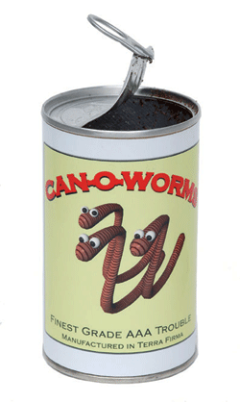
This working definition of creativity is ok… isn’t it?
Creativity =
novelty
+ value
+ …??

Slide 7
Motivations for defining creativity
To clarify aims and goals for creativity research
To improve our understanding of creativity
To guide computational creativity systems

Slide 8
Background: music impro + creativity
Notes:
Hypothesis: • if an improvisation contains more evidence of emotion-laden content, it is more likely to be recognised as creative What do I need • data ranking most creative improvisations • data for multiple improvisations • ml model eg transformer trained on valence/arousal (soleymani et al?) - benetos et al 2021? Assumption that git repo using Spotipy won't work any more • library to calculate J&L features - librosa? Super collider? • do I want to get human input for validation? Or is the ranking enough? • Data on popularity of artists in dataset (spotipy?) • Literature survey on MER music emotion recognition, especially anything looking at creativity- MAY INFLUENCE METHOD • Stats method to analyse results across songs • organising data into sets for analysis, need to cross check against data on popularity+year as well as matching across a lead sheet • check for different songs with same name eg moaning Method • collect data as above • implement J&L features for input audio with 5d vector as output (is this actually the first paper? See issues)(and Russell model? With 2d output vector, to see if overall emotion has effect). Output = emovectors? (Check if that had been used) • Get emovectors :) for each song in analysis data • Statistical analysis across songs matched to ranking to verify hypothesis Issues • isolating individual improvisations vs analysing the whole track- this needs to be clearly linked to the rankings • rankings need to be very solid benchmarks • Is the impro creative because of the individual improvising, or the group? I assume collective creativity - why? Because music impro is inherently social (citation) and group impro is constructed around interaction (cite, jazz theory examples too) * to what extent does the chord sequence/ lead sheet melody influence creativity? In this work, this is controlled for through analysing multiple examples over the same chord sequence. Where possible, will also compare improvisations seeded from different lead sheet melodies, using the same chord sequence eg 12 bar blues, rhythm changes * Rankings will be biased by popularity of the musicians involved and how well known they are - control by looking at tracks matched by rough date, and also will be interesting to evaluate newer tracks by lesser known artists - can I detect up and coming stars? (Can use spotipy for metadata on artist popularity, will need to be scaled relative to all jazz artists in my dataset) * jazz is a term that covers many sub genres, how appropriate is it to compare, say free jazz to dixie? ..... maybe can check this in analysis if deep enough data * what about improvisations that aren't jazz? Maybe i need to be careful here and say 'impro' rather than jazz, though that might not work as the leadsheet/chord sequence idea is inspired by jazz. I need to be careful how to frame this. I can emphasise my scope is on improvisations around a lead sheet/ chord sequence model (explain what this is), typically but not exclusively found in jazz impro... acknowledging too that not all jazz is in this model (I can cite Alex Hawkins as example!) * I assume that for J&L all audio features contribute equally to the emotion... check original paper and any follow up work. Can i validate this against any annotated datasets (ideally jazz)? Is this actually the first paper? * is it worth doing analysis across an artist, to calculate their most creative impro? Might be verifiable against people's rankings? Controversial again otherwise, but possible. Difficulty with groups- what is the artist? The lead name on the record? Or that specific combination of musicians? Could be a fun initial experiment pointing to future work? Assumptions: * Improvisation is creative process where the outputs are closely tied to the live process. • emotional content in the music can be used as a proxy for emotional involvement • emotional content can be represented using either Russell valence and arousal model or the 5 key emotions as captured by Juslin and Laukka. Russell ok for summative but not for magnitude, so J&L better? • Intention and emotional involvement are recognised outside my work, as part of the key contributors to musical creativity (alongside social interaction and communication, and domain competence) • I can use 'song' or 'chart' to represent lead sheet plus chord (chart probably better, but more confusing for a non jazzer?) Future work • intention - can this be captured by showing presence of a musical narrative? How? • how does the chord sequence influence creativity potential? Future work on optimising chord sequences for creativity • could analyse creativity of an individual artist across different groups.. see in what groups they (collectively) produce most creative impro..... but difficult to do without

Slide 9
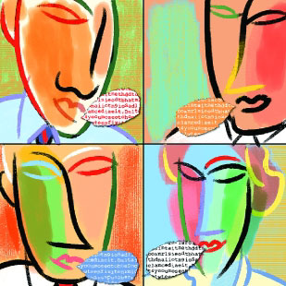

An empirical definition of creativity
Let’s analyse the language used to talk
in-depth about creativity:
What words do we keep on using?
What key themes or factors are revealed by these words?
Methodology:
compare papers on creativity / not on creativity
identify ‘creativity words’ using a statistical test
cluster similar words together

Slide 10
Empirical definition of creativity
Analyse the language used to talk about creativity:
What words appear to be highly associated with discussion of creativity?
What key themes or factors emerge?
inspired by cognitive linguistics ideas that a word’s meaning is defined by how it is used
Methodology -- a corpus-based approach:
identify ‘creativity words’ using a statistical test
automatically cluster words according to similarity of meaning
analyse clusters to identify key components of creativity

Slide 11
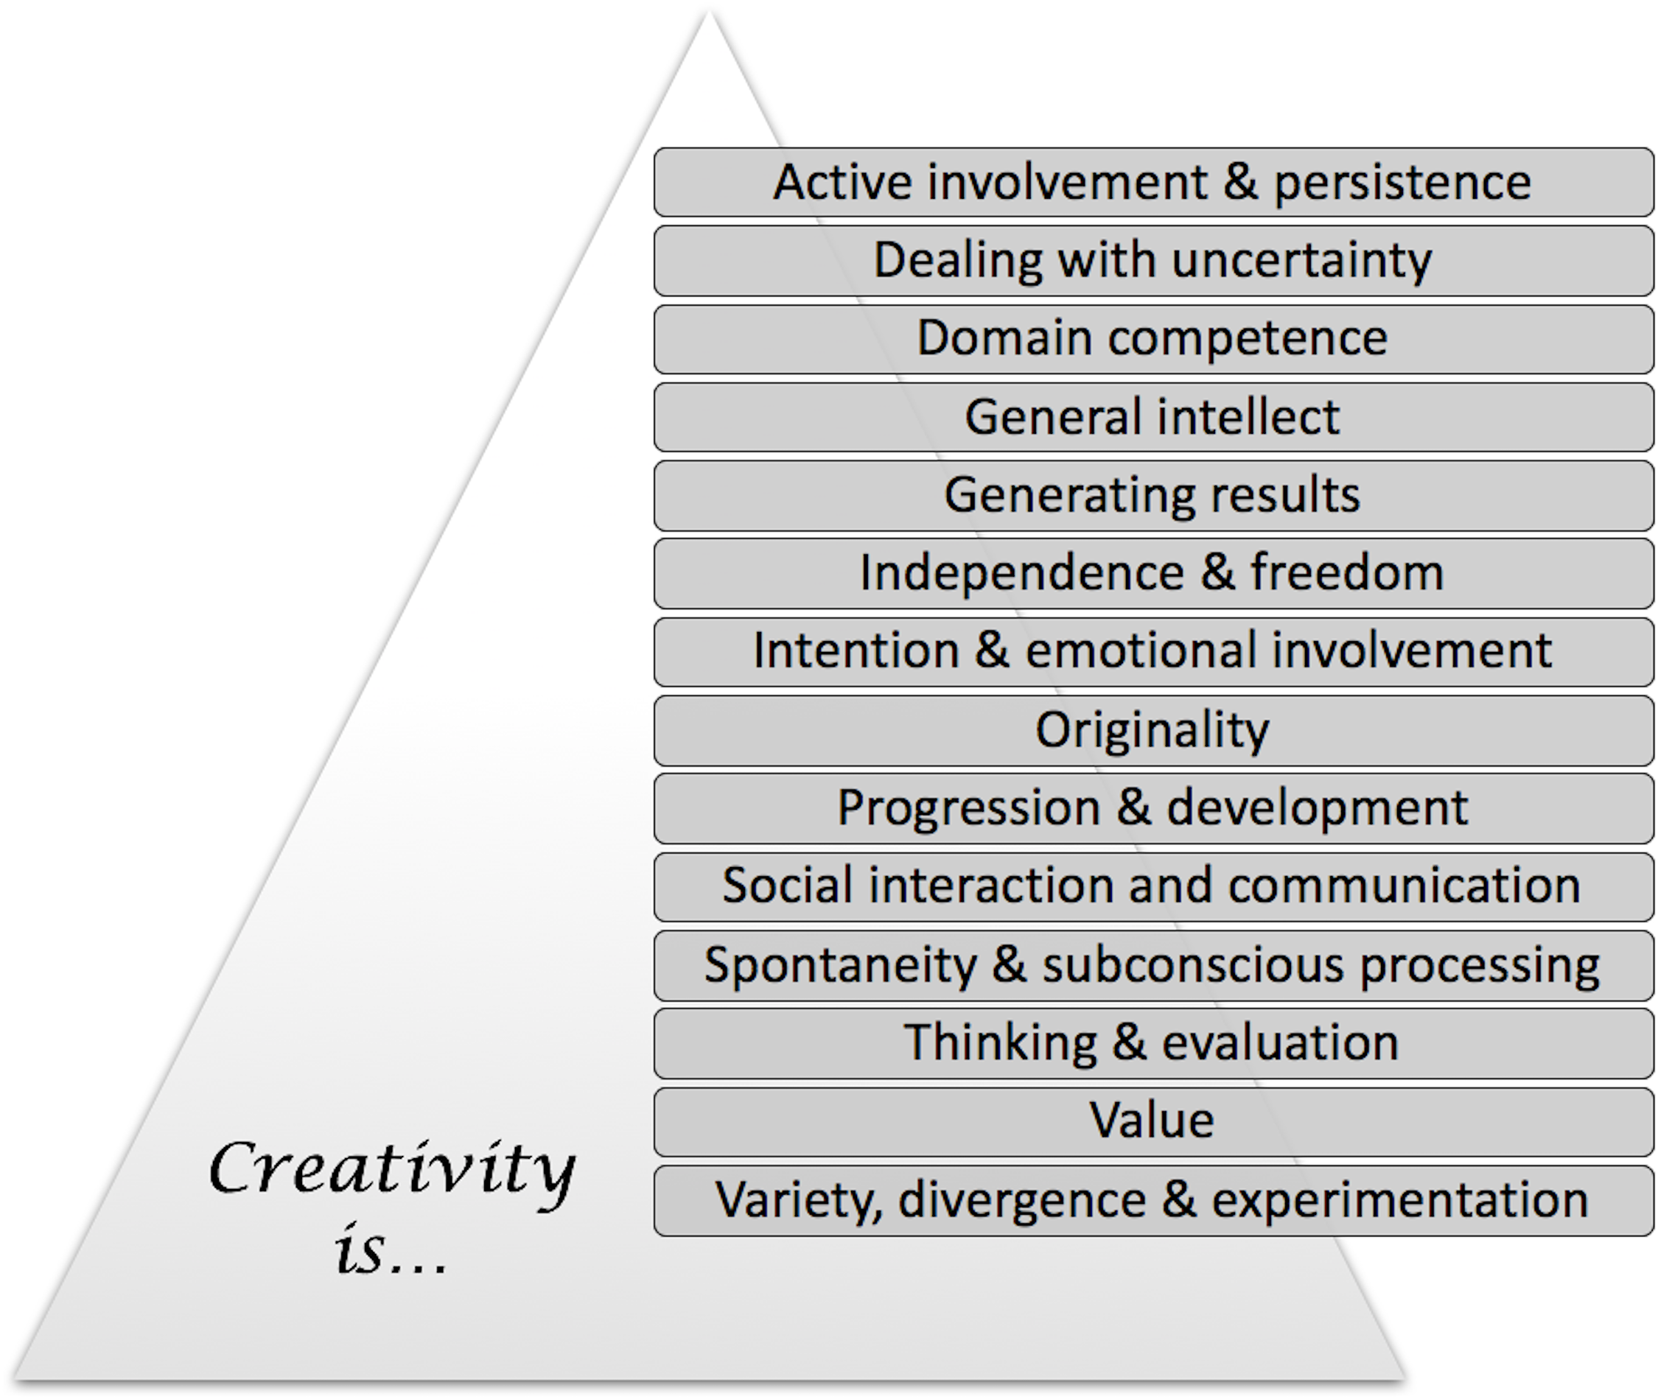
Results: Key components of creativity
Analysis of clusters yields 14 key components
Jordanous, Anna and Keller, Bill (2016) Modelling Creativity: Identifying Key Components through a Corpus-Based Approach. PLoS ONE 11(10): e0162959.
https://doi.org/10.1371/journal.pone.0162959

Slide 12
https://tinyurl.com/thisiscreativity
Dealing with uncertainty
Domain competence
General intellectual ability
Generating results
Independence & freedom
Progression & development
Intention & emotional involvement
Originality
Social interaction and communication
Spontaneity & subconscious processing
Value
Variety, divergence & experimentation
Thinking & evaluation
Active involvement & persistence
Creativity is…
Variety, divergence & experimentation
Active involvement & persistence
Dealing with uncertainty
Value
Domain competence
Thinking & evaluation
General intellectual ability
Spontaneity & subconscious processing
Generating results
Social interaction and communication
Independence & freedom
How do these apply for your examples of being creative?
Progression & development
Intention & emotional involvement
Originality

Slide 13
Jordanous and Keller (2012)
What is creativity when improvising music?
Value
Dealing with uncertainty
Domain competence
General intellect
Generating results
Independence & freedom
Progression & development
Intention & emotional involvement
Social interaction & communication
Originality
Spontaneity & subconscious processing
Thinking & evaluation
Variety, divergence & experimentation
Active involvement & persistence

Slide 14
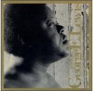

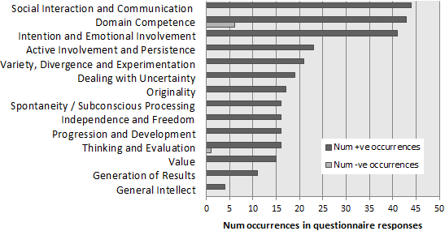
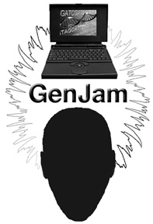
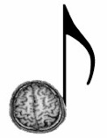
So what can we do with this information?

Slide 15
Hypothesis
if an improvisation contains more evidence of emotion-laden content, it is more likely to be recognised as creative

Slide 16
Computational modelling of emotion
how to model human emotions in a computational way?
so computers can detect and respond to people’s emotions
two leading theories for representing emotion:
Ekman’s six basic emotions (Ekman, 1992)
Russel’s circumplex model (Russel, 1980)

Slide 17
Computational modelling of emotion: Ekman’s six basic emotions
Ekman, P. (1992). An argument for basic emotions. Cognition & Emotion. http://doi.org/10.1080/02699939208411068
https://ocw.mit.edu/courses/brain-and-cognitive-sciences/9-00sc-introduction-to-psychology-fall-2011/emotion-motivation/discussion-emotion/diss_img.jpg

Slide 18
Computational modelling of emotion: Russell’s circumplex model of emotion
Russell, J. A. (1980) ‘‘A Circumplex Model of Affect’’, Journal of Personality and Social Psychology 39: 1161–78.

Slide 19
Computational modelling of emotion: Russell++
K.R. Scherer, “What Are Emotions? And How Can They Be Measured?” Social Science Information, vol. 44, no. 4, pp. 695-729, 2005.
Paltoglou, G., & Thelwall, M. (2013). Seeing stars of valence and arousal in blog posts. IEEE Transactions on Affective Computing, 4(1), 116–123.

Slide 20
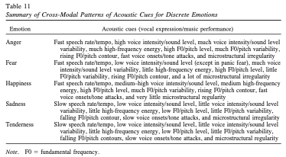
Emotions in music
P. N. Juslin & P. Laukka (2003) Communication of Emotions in Vocal Expression and Music Performance: Different Channels, Same Code? Psychological Bulletin Vol. 129, No. 5, 770–814.

Slide 21
What’s next – detecting emotions by vocal cues?
Juslin, P. N., & Laukka, P. (2003). Communication of emotions in vocal expression and music performance: different channels, same code? Psychological Bulletin, 129(5).

Slide 22
Emotions in music
Emotion | Acoustic cues (vocal expression/music performance)
Anger | Fast speech rate/tempo, high voice intensity/sound level, much voice intensity/sound level variability, much high-frequency energy, high F0/pitch level, much F0/pitch variability, rising F0/pitch contour, fast voice onsets/tone attacks, and microstructural irregularity
Fear | Fast speech rate/tempo, low voice intensity/sound level (except in panic fear), much voice intensity/sound level variability, little high-frequency energy, high F0/pitch level, little F0/pitch variability, rising F0/pitch contour, and a lot of microstructural irregularity
Happiness | Fast speech rate/tempo, medium–high voice intensity/sound level, medium high-frequency energy, high F0/pitch level, much F0/pitch variability, rising F0/pitch contour, fast voice onsets/tone attacks, and very little microstructural regularity
Sadness | Slow speech rate/tempo, low voice intensity/sound level, little voice intensity/sound level variability, little high-frequency energy, low F0/pitch level, little F0/pitch variability, falling F0/pitch contour, slow voice onsets/tone attacks, and microstructural irregularity
Tenderness | Slow speech rate/tempo, low voice intensity/sound level, little voice intensity/sound level variability, little high-frequency energy, low F0/pitch level, little F0/pitch variability, falling F0/pitch contours, slow voice onsets/tone attacks, and microstructural regularity
 | Note. F0 fundamental frequency.
Summary of Cross-Modal Patterns of Acoustic Cues for Discrete Emotions
P. N. Juslin & P. Laukka (2003) Communication of Emotions in Vocal Expression and Music Performance: Different Channels, Same Code? Psychological Bulletin Vol. 129, No. 5, 770–814.

Slide 23
Assumptions
Assumptions: * Improvisation is creative process where the outputs are closely tied to the live process. • emotional content in the music can be used as a proxy for emotional involvement • emotional content can be represented using either Russell valence and arousal model or the 5 key emotions as captured by Juslin and Laukka. Russell ok for summative but not for magnitude, so J&L better? • Intention and emotional involvement are recognised outside my work, as part of the key contributors to musical creativity (alongside social interaction and communication, and domain competence) • I can use 'song' or 'chart' to represent lead sheet plus chord (chart probably better, but more confusing for a non jazzer?)

Slide 24
What do I need?
• data ranking most creative improvisations • data for multiple improvisations • ml model eg transformer trained on valence/arousal (soleymani et al?) - benetos et al 2021? Assumption that git repo using Spotipy won't work any more • library to calculate J&L features - librosa? Super collider? • do I want to get human input for validation? Or is the ranking enough? • Data on popularity of artists in dataset (spotipy?) • Literature survey on MER music emotion recognition, especially anything looking at creativity- MAY INFLUENCE METHOD • Stats method to analyse results across songs • organising data into sets for analysis, need to cross check against data on popularity+year as well as matching across a lead sheet • check for different songs with same name eg moaning

Slide 25
Data
Audio:
Filosax https://dave-foster.github.io/filosax/
Jordan:Jazz https://github.com/jblsmith/ma-thesis
RWC Music Database http://staff.aist.go.jp/m.goto/RWC-MDB/ Jazz Music Database
Weimar Jazz database https://jazzomat.hfm-weimar.de/dbformat/dboverview.html
DTL1000 (dig that lick) https://reshare.ukdataservice.ac.uk/854781/ https://dig-that-lick.eecs.qmul.ac.uk/index.html https://osf.io/6jm8x

Slide 26
Methodology
• collect data as above • implement J&L features for input audio with 5d vector as output (is this actually the first paper? See issues)(and Russell model? With 2d output vector, to see if overall emotion has effect). Output = emovectors? (Check if that had been used) • Get emovectors :) for each song in analysis data • Statistical analysis across songs matched to ranking to verify hypothesis

Slide 27
Next steps
Statistical analysis across songs matched to ranking to verify hypothesis
Better data
Validation with human participants?
TODO: submit paper
TODO: submit grant proposal

Slide 28
Paper abstract
Music improvisation is fascinating to study, being essentially a live demonstration of a creative process. In jazz, musicians often improvise across predefined chord progressions (leadsheets). How do we assess the creativity of jazz improvisations? And can we capture this in automated metrics for creativity for current LLM-based generative systems? Demonstration of emotional involvement is closely linked with creativity in improvisation. Analysing musical audio, can we detect emotional involvement? This study hypothesises that if an improvisation contains more evidence of emotion-laden content, it is more likely to be recognised as creative. An embeddings-based method is proposed for capturing the emotional content in musical improvisations, using Juslin \& Laukka (2004)’s classification of musical characteristics associated with emotions. Resulting ‘emovectors’ are analysed to test the above hypothesis, comparing across multiple matched monophonic improvisations. Capturing emotional content in this quantifiable way can contribute towards new metrics for creativity evaluation.

Slide 29
Issues still to solve(?)
• isolating individual improvisations vs analysing the whole track- this needs to be clearly linked to the rankings • rankings need to be very solid benchmarks • Is the impro creative because of the individual improvising, or the group? I assume collective creativity - why? Because music impro is inherently social (citation) and group impro is constructed around interaction (cite, jazz theory examples too) * to what extent does the chord sequence/ lead sheet melody influence creativity? In this work, this is controlled for through analysing multiple examples over the same chord sequence. Where possible, will also compare improvisations seeded from different lead sheet melodies, using the same chord sequence eg 12 bar blues, rhythm changes * Rankings will be biased by popularity of the musicians involved and how well known they are - control by looking at tracks matched by rough date, and also will be interesting to evaluate newer tracks by lesser known artists - can I detect up and coming stars? (Can use spotipy for metadata on artist popularity, will need to be scaled relative to all jazz artists in my dataset) * jazz is a term that covers many sub genres, how appropriate is it to compare, say free jazz to dixie? ..... maybe can check this in analysis if deep enough data * what about improvisations that aren't jazz? Maybe i need to be careful here and say 'impro' rather than jazz, though that might not work as the leadsheet/chord sequence idea is inspired by jazz. I need to be careful how to frame this. I can emphasise my scope is on improvisations around a lead sheet/ chord sequence model (explain what this is), typically but not exclusively found in jazz impro... acknowledging too that not all jazz is in this model (I can cite Alex Hawkins as example!) * I assume that for J&L all audio features contribute equally to the emotion... check original paper and any follow up work. Can i validate this against any annotated datasets (ideally jazz)? Is this actually the first paper? * is it worth doing analysis across an artist, to calculate their most creative impro? Might be verifiable against people's rankings? Controversial again otherwise, but possible. Difficulty with groups- what is the artist? The lead name on the record? Or that specific combination of musicians? Could be a fun initial experiment pointing to future work?

Slide 30
So What?
Notes:
Hypothesis: • if an improvisation contains more evidence of emotion-laden content, it is more likely to be recognised as creative What do I need • data ranking most creative improvisations • data for multiple improvisations • ml model eg transformer trained on valence/arousal (soleymani et al?) - benetos et al 2021? Assumption that git repo using Spotipy won't work any more • library to calculate J&L features - librosa? Super collider? • do I want to get human input for validation? Or is the ranking enough? • Data on popularity of artists in dataset (spotipy?) • Literature survey on MER music emotion recognition, especially anything looking at creativity- MAY INFLUENCE METHOD • Stats method to analyse results across songs • organising data into sets for analysis, need to cross check against data on popularity+year as well as matching across a lead sheet • check for different songs with same name eg moaning Method • collect data as above • implement J&L features for input audio with 5d vector as output (is this actually the first paper? See issues)(and Russell model? With 2d output vector, to see if overall emotion has effect). Output = emovectors? (Check if that had been used) • Get emovectors :) for each song in analysis data • Statistical analysis across songs matched to ranking to verify hypothesis Issues • isolating individual improvisations vs analysing the whole track- this needs to be clearly linked to the rankings • rankings need to be very solid benchmarks • Is the impro creative because of the individual improvising, or the group? I assume collective creativity - why? Because music impro is inherently social (citation) and group impro is constructed around interaction (cite, jazz theory examples too) * to what extent does the chord sequence/ lead sheet melody influence creativity? In this work, this is controlled for through analysing multiple examples over the same chord sequence. Where possible, will also compare improvisations seeded from different lead sheet melodies, using the same chord sequence eg 12 bar blues, rhythm changes * Rankings will be biased by popularity of the musicians involved and how well known they are - control by looking at tracks matched by rough date, and also will be interesting to evaluate newer tracks by lesser known artists - can I detect up and coming stars? (Can use spotipy for metadata on artist popularity, will need to be scaled relative to all jazz artists in my dataset) * jazz is a term that covers many sub genres, how appropriate is it to compare, say free jazz to dixie? ..... maybe can check this in analysis if deep enough data * what about improvisations that aren't jazz? Maybe i need to be careful here and say 'impro' rather than jazz, though that might not work as the leadsheet/chord sequence idea is inspired by jazz. I need to be careful how to frame this. I can emphasise my scope is on improvisations around a lead sheet/ chord sequence model (explain what this is), typically but not exclusively found in jazz impro... acknowledging too that not all jazz is in this model (I can cite Alex Hawkins as example!) * I assume that for J&L all audio features contribute equally to the emotion... check original paper and any follow up work. Can i validate this against any annotated datasets (ideally jazz)? Is this actually the first paper? * is it worth doing analysis across an artist, to calculate their most creative impro? Might be verifiable against people's rankings? Controversial again otherwise, but possible. Difficulty with groups- what is the artist? The lead name on the record? Or that specific combination of musicians? Could be a fun initial experiment pointing to future work? Assumptions: * Improvisation is creative process where the outputs are closely tied to the live process. • emotional content in the music can be used as a proxy for emotional involvement • emotional content can be represented using either Russell valence and arousal model or the 5 key emotions as captured by Juslin and Laukka. Russell ok for summative but not for magnitude, so J&L better? • Intention and emotional involvement are recognised outside my work, as part of the key contributors to musical creativity (alongside social interaction and communication, and domain competence) • I can use 'song' or 'chart' to represent lead sheet plus chord (chart probably better, but more confusing for a non jazzer?) Future work • intention - can this be captured by showing presence of a musical narrative? How? • how does the chord sequence influence creativity potential? Future work on optimising chord sequences for creativity • could analyse creativity of an individual artist across different groups.. see in what groups they (collectively) produce most creative impro..... but difficult to do without

Slide 31
Future work
• intention - can this be captured by showing presence of a musical narrative? How? • how does the chord sequence influence creativity potential? Future work on optimising chord sequences for creativity • could analyse creativity of an individual artist across different groups.. see in what groups they (collectively) produce most creative impro..... but difficult to do without

Slide 32
Summary: Measuring intention and emotional involvement in jazz music
Overview of this work in progress
Part of a wider project on optimising AI for creativity
Background
Creativity in music improvisation
Emotions in music
Methodology and results so far
Next steps and issues still to solve
Summary
Notes:
Hypothesis: • if an improvisation contains more evidence of emotion-laden content, it is more likely to be recognised as creative What do I need • data ranking most creative improvisations • data for multiple improvisations • ml model eg transformer trained on valence/arousal (soleymani et al?) - benetos et al 2021? Assumption that git repo using Spotipy won't work any more • library to calculate J&L features - librosa? Super collider? • do I want to get human input for validation? Or is the ranking enough? • Data on popularity of artists in dataset (spotipy?) • Literature survey on MER music emotion recognition, especially anything looking at creativity- MAY INFLUENCE METHOD • Stats method to analyse results across songs • organising data into sets for analysis, need to cross check against data on popularity+year as well as matching across a lead sheet • check for different songs with same name eg moaning Method • collect data as above • implement J&L features for input audio with 5d vector as output (is this actually the first paper? See issues)(and Russell model? With 2d output vector, to see if overall emotion has effect). Output = emovectors? (Check if that had been used) • Get emovectors :) for each song in analysis data • Statistical analysis across songs matched to ranking to verify hypothesis Issues • isolating individual improvisations vs analysing the whole track- this needs to be clearly linked to the rankings • rankings need to be very solid benchmarks • Is the impro creative because of the individual improvising, or the group? I assume collective creativity - why? Because music impro is inherently social (citation) and group impro is constructed around interaction (cite, jazz theory examples too) * to what extent does the chord sequence/ lead sheet melody influence creativity? In this work, this is controlled for through analysing multiple examples over the same chord sequence. Where possible, will also compare improvisations seeded from different lead sheet melodies, using the same chord sequence eg 12 bar blues, rhythm changes * Rankings will be biased by popularity of the musicians involved and how well known they are - control by looking at tracks matched by rough date, and also will be interesting to evaluate newer tracks by lesser known artists - can I detect up and coming stars? (Can use spotipy for metadata on artist popularity, will need to be scaled relative to all jazz artists in my dataset) * jazz is a term that covers many sub genres, how appropriate is it to compare, say free jazz to dixie? ..... maybe can check this in analysis if deep enough data * what about improvisations that aren't jazz? Maybe i need to be careful here and say 'impro' rather than jazz, though that might not work as the leadsheet/chord sequence idea is inspired by jazz. I need to be careful how to frame this. I can emphasise my scope is on improvisations around a lead sheet/ chord sequence model (explain what this is), typically but not exclusively found in jazz impro... acknowledging too that not all jazz is in this model (I can cite Alex Hawkins as example!) * I assume that for J&L all audio features contribute equally to the emotion... check original paper and any follow up work. Can i validate this against any annotated datasets (ideally jazz)? Is this actually the first paper? * is it worth doing analysis across an artist, to calculate their most creative impro? Might be verifiable against people's rankings? Controversial again otherwise, but possible. Difficulty with groups- what is the artist? The lead name on the record? Or that specific combination of musicians? Could be a fun initial experiment pointing to future work? Assumptions: * Improvisation is creative process where the outputs are closely tied to the live process. • emotional content in the music can be used as a proxy for emotional involvement • emotional content can be represented using either Russell valence and arousal model or the 5 key emotions as captured by Juslin and Laukka. Russell ok for summative but not for magnitude, so J&L better? • Intention and emotional involvement are recognised outside my work, as part of the key contributors to musical creativity (alongside social interaction and communication, and domain competence) • I can use 'song' or 'chart' to represent lead sheet plus chord (chart probably better, but more confusing for a non jazzer?) Future work • intention - can this be captured by showing presence of a musical narrative? How? • how does the chord sequence influence creativity potential? Future work on optimising chord sequences for creativity • could analyse creativity of an individual artist across different groups.. see in what groups they (collectively) produce most creative impro..... but difficult to do without

